Slide 1










18°C
40%
Logout
22
°C
A
HEAT
COOL
AUTO
REPORT
SETTING

Slide 2
HAVC
COM port
Baud rate
LIG Nex1
Connect

Slide 3
18°C
HAVC
40%
LIG Nex1
Admin Password
Disconnect
Login

Slide 4

18°C
40%
Logout
A
HEAT
COOL
AUTO
REPORT
SETTING

Slide 5
18°C
40%
Logout
22
°C
A
HEAT
COOL
AUTO
REPORT
SETTING

Slide 6
18°C
40%
Logout
22
°C
A
HEAT
COOL
AUTO
REPORT
SETTING

Slide 7
18°C
40%
Logout
22
°C
A
HEAT
COOL
AUTO
REPORT
SETTING

Slide 8


18°C
40%
Logout
+
22°C
CLOSE
WARNING!!
+
-
-
유해가스가 감지되었습니다!!
A
HEAT
COOL
AUTO
REPORT
SETTING

Slide 9

22
°C
SAVE
HEAT
COOL

Slide 10
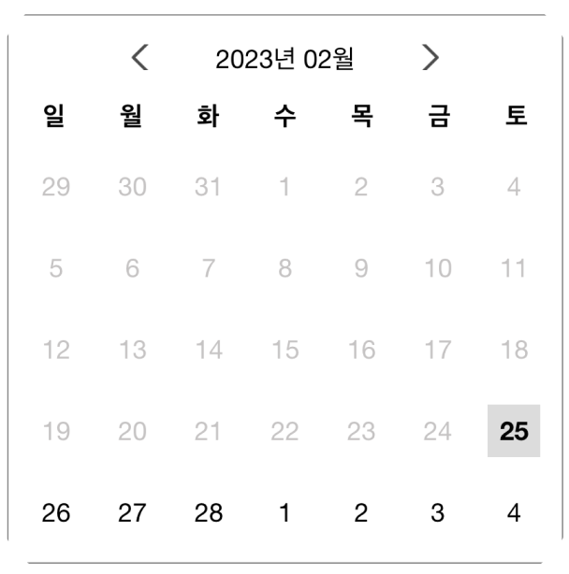
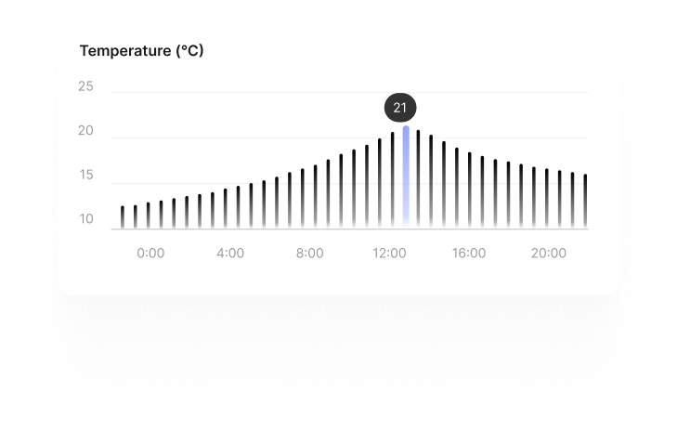
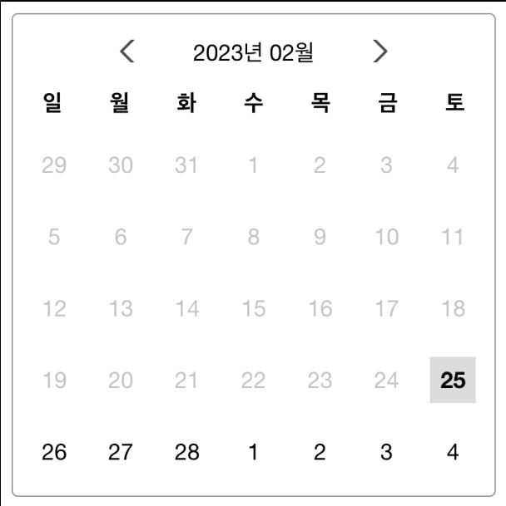
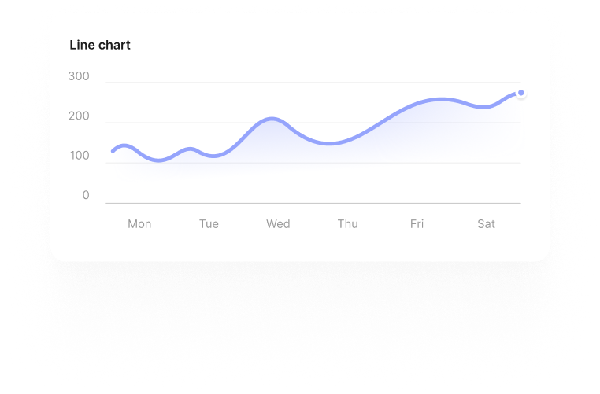
yyyy/mm…
~
yyyy/mm…

Slide 11
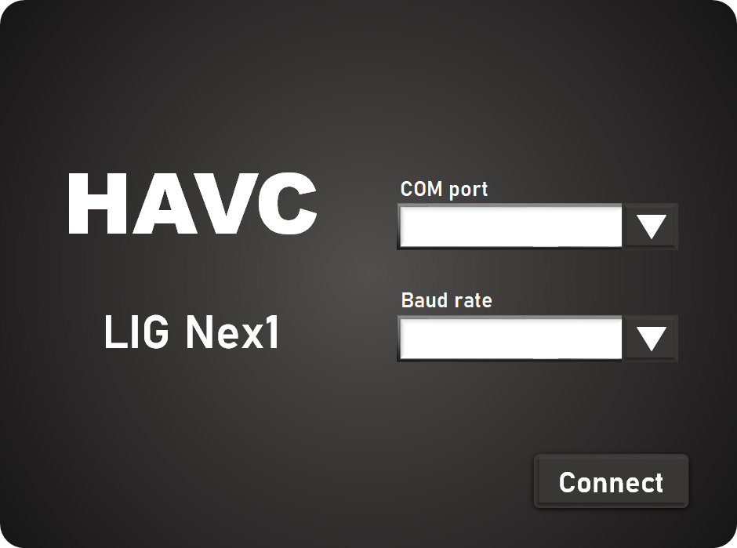
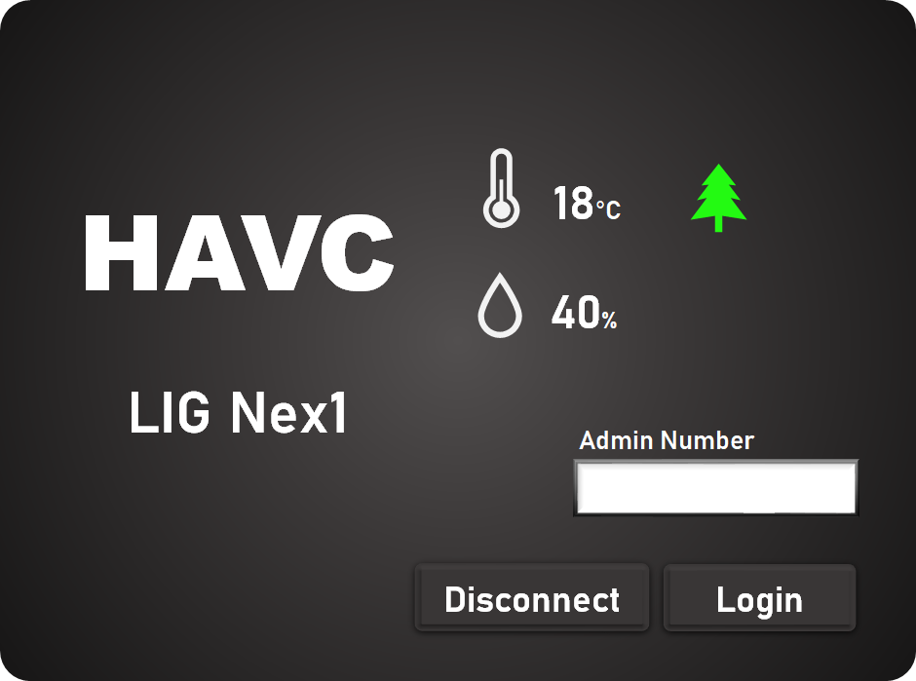
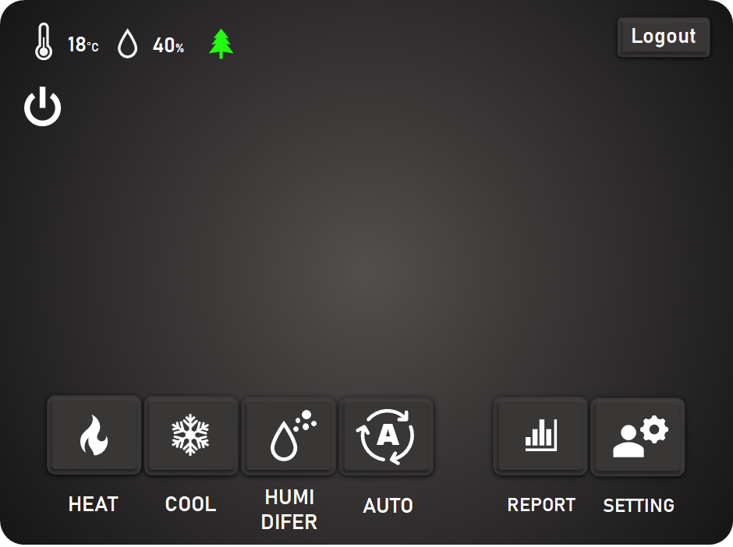
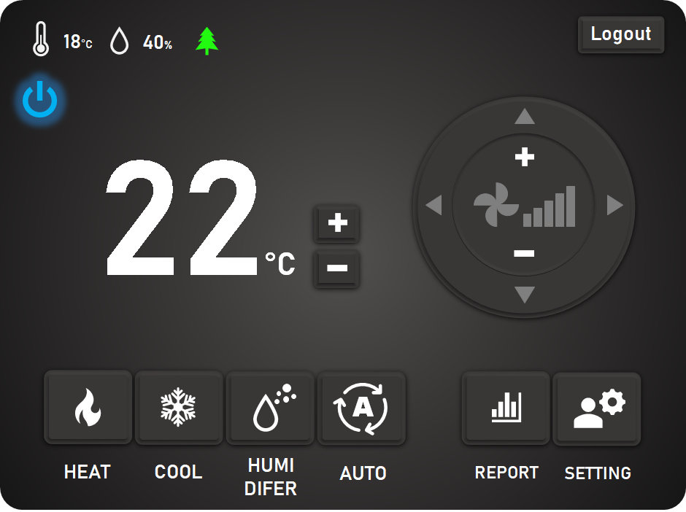
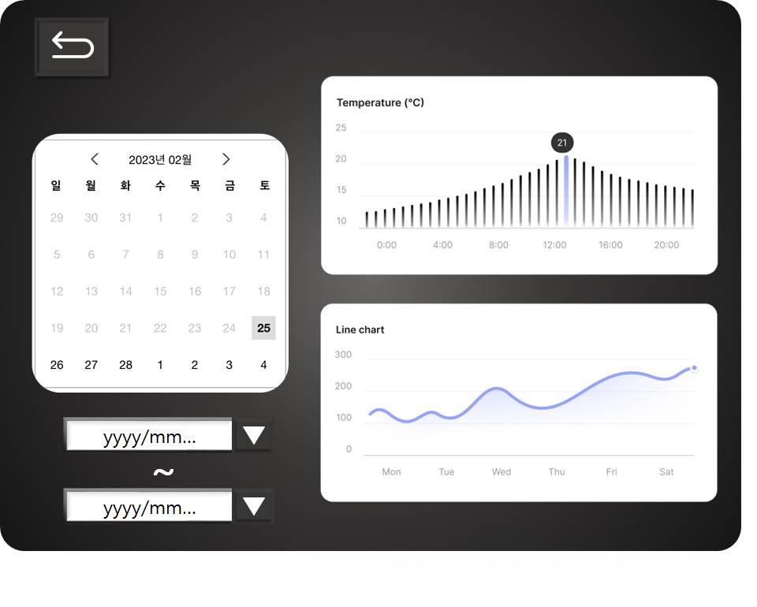
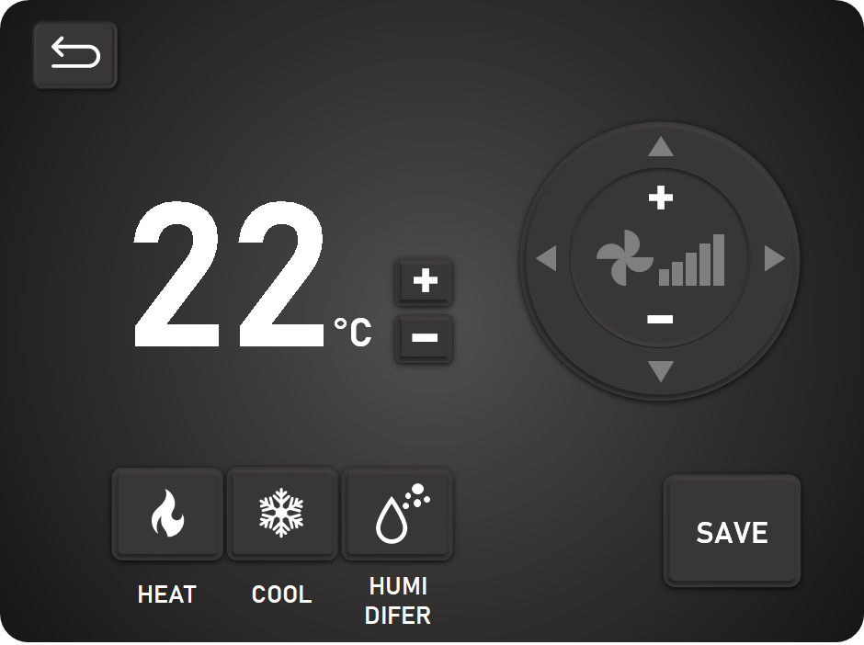

Slide 12

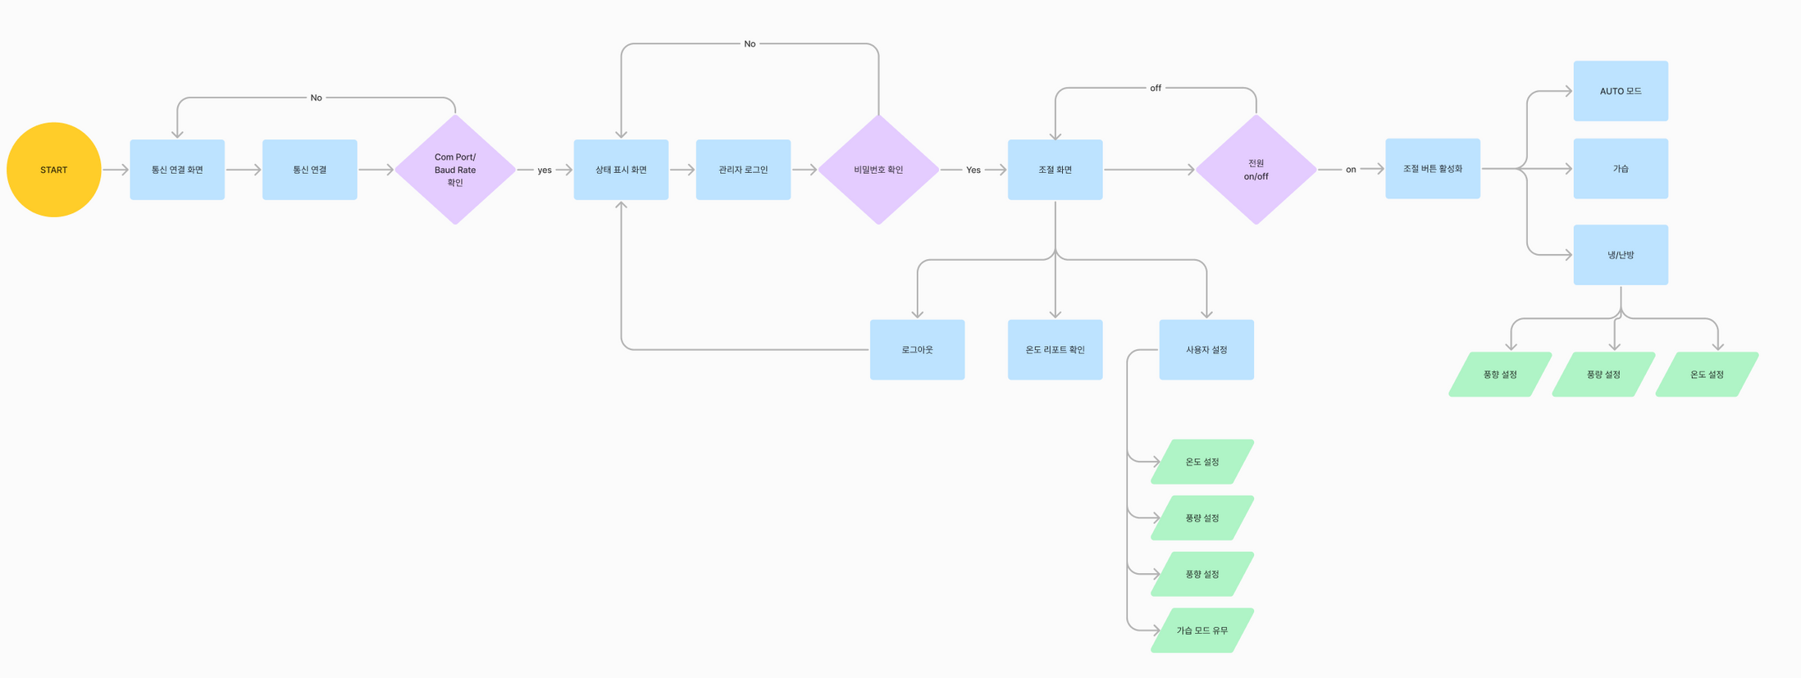


GUI 설계
Flow Chart

Slide 13
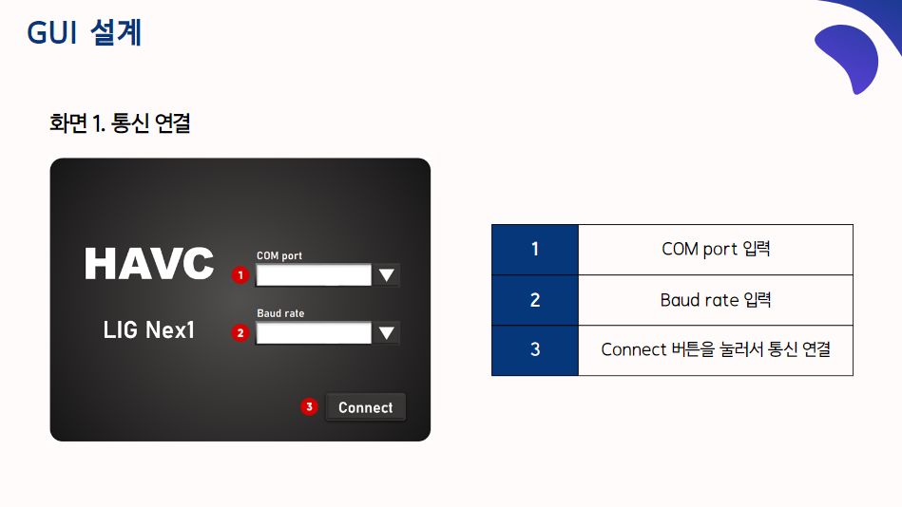

Slide 14
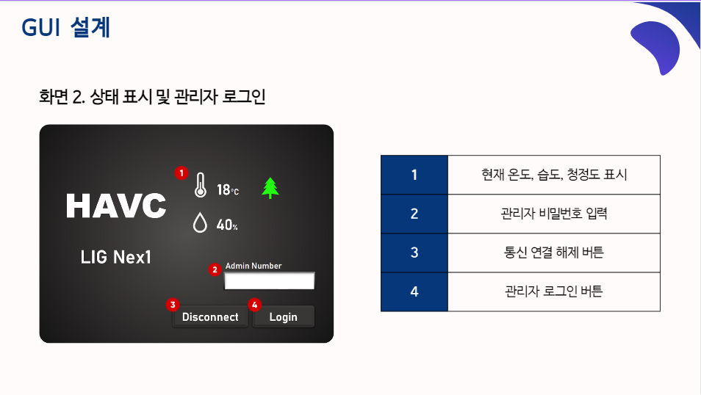

Slide 15
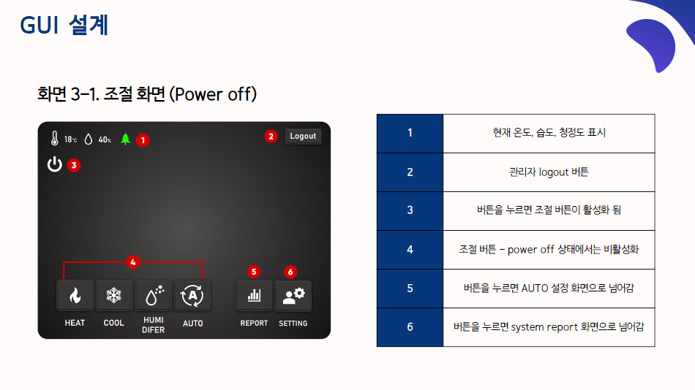

Slide 16
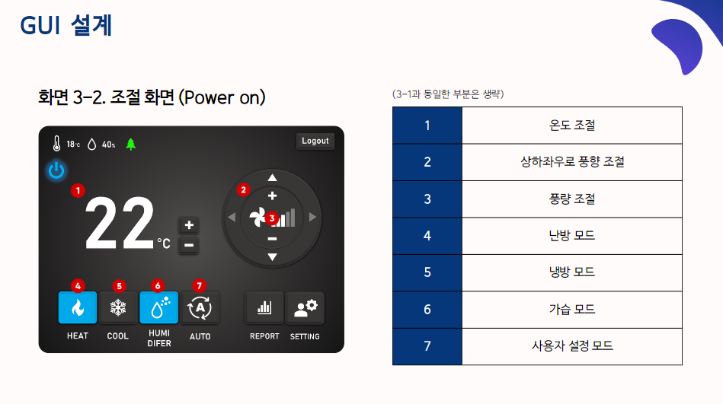

Slide 17
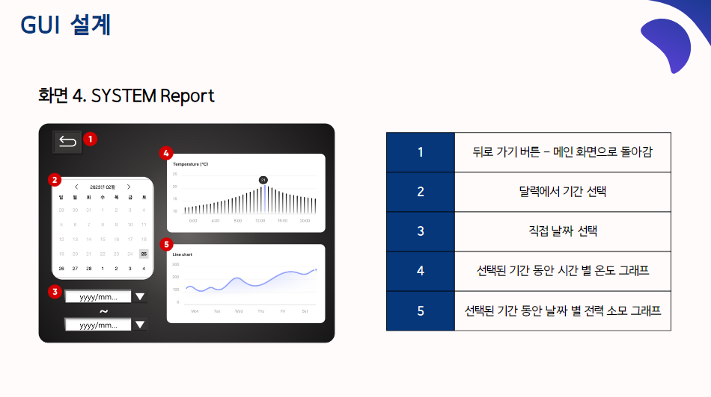

Slide 18
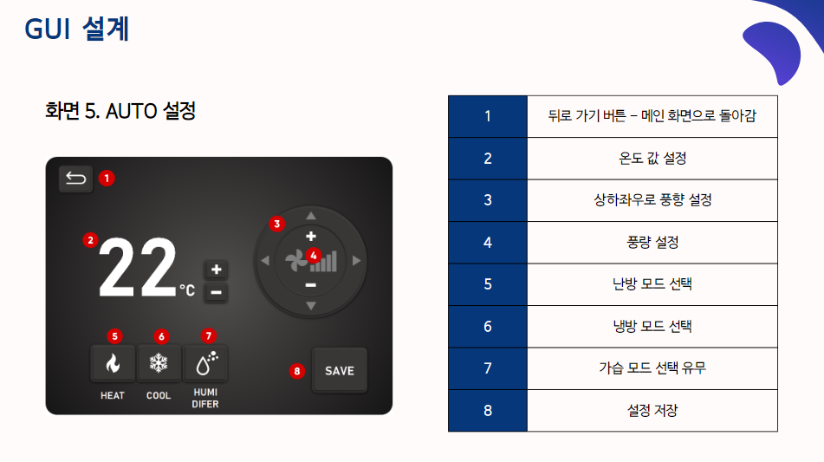

Slide 19

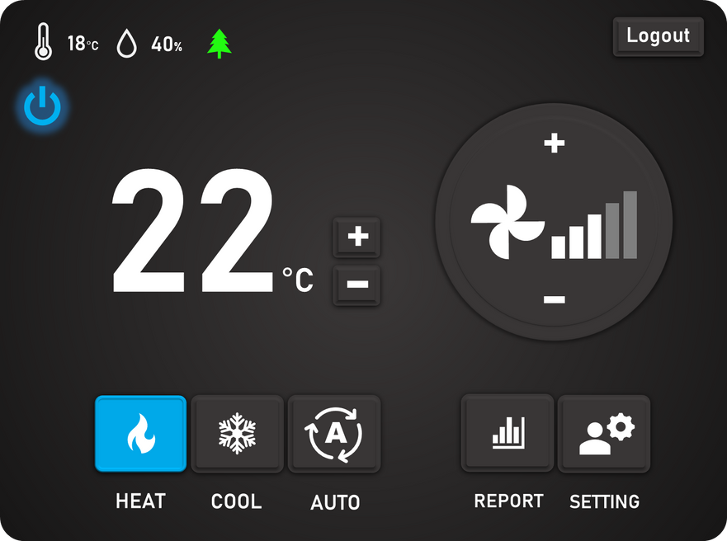




03
운용절차 - IV. GUI
GUI : UI/UX 디자인
기능 비활성화, 활성화
풍량 조절 활성화
난방, 풍량 3단계 활성화 예시

